Slide 1
[ADM22JF056] – [ONLINE BAKERY]
POD – 1
Members:
1.Md. Mehmood Alam
2.Priyanjali Das
3.Srinjoy Gupta
4.Debanjan Dhar
5.Shafaque Bushra
_____________
Date of Design : 08/06/2022

Slide 2
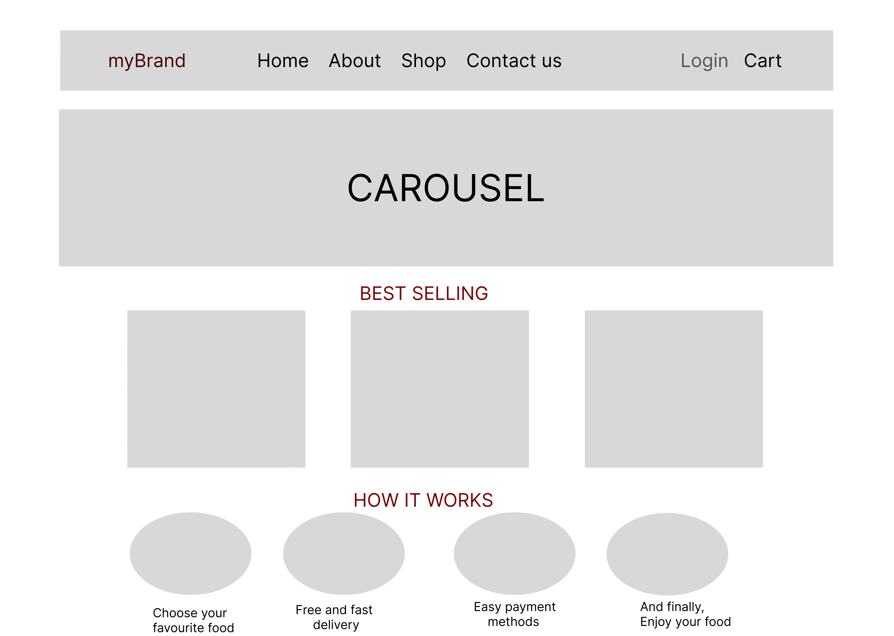

Slide 3
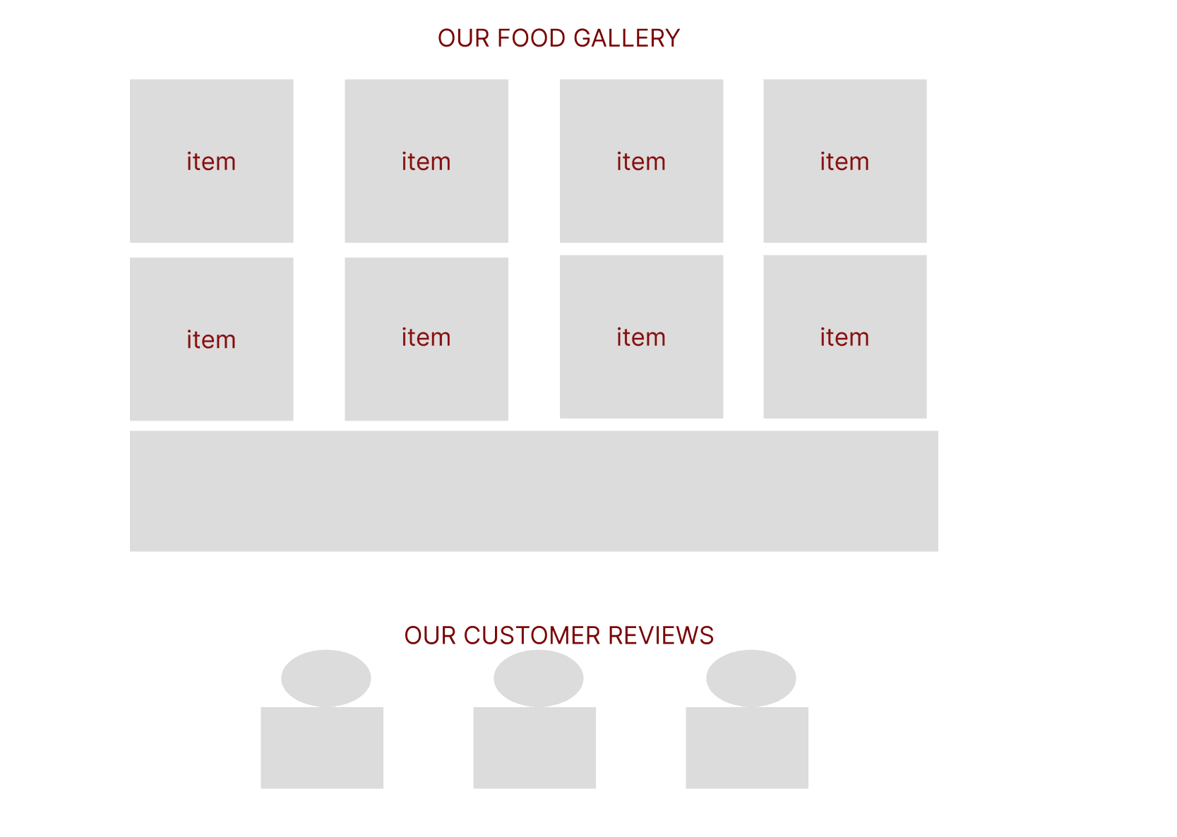

Slide 4
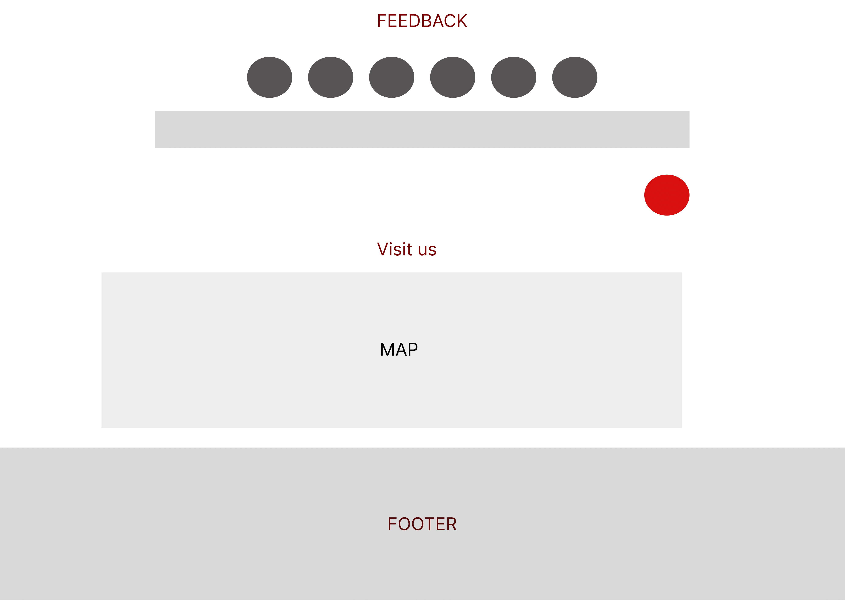

Slide 5
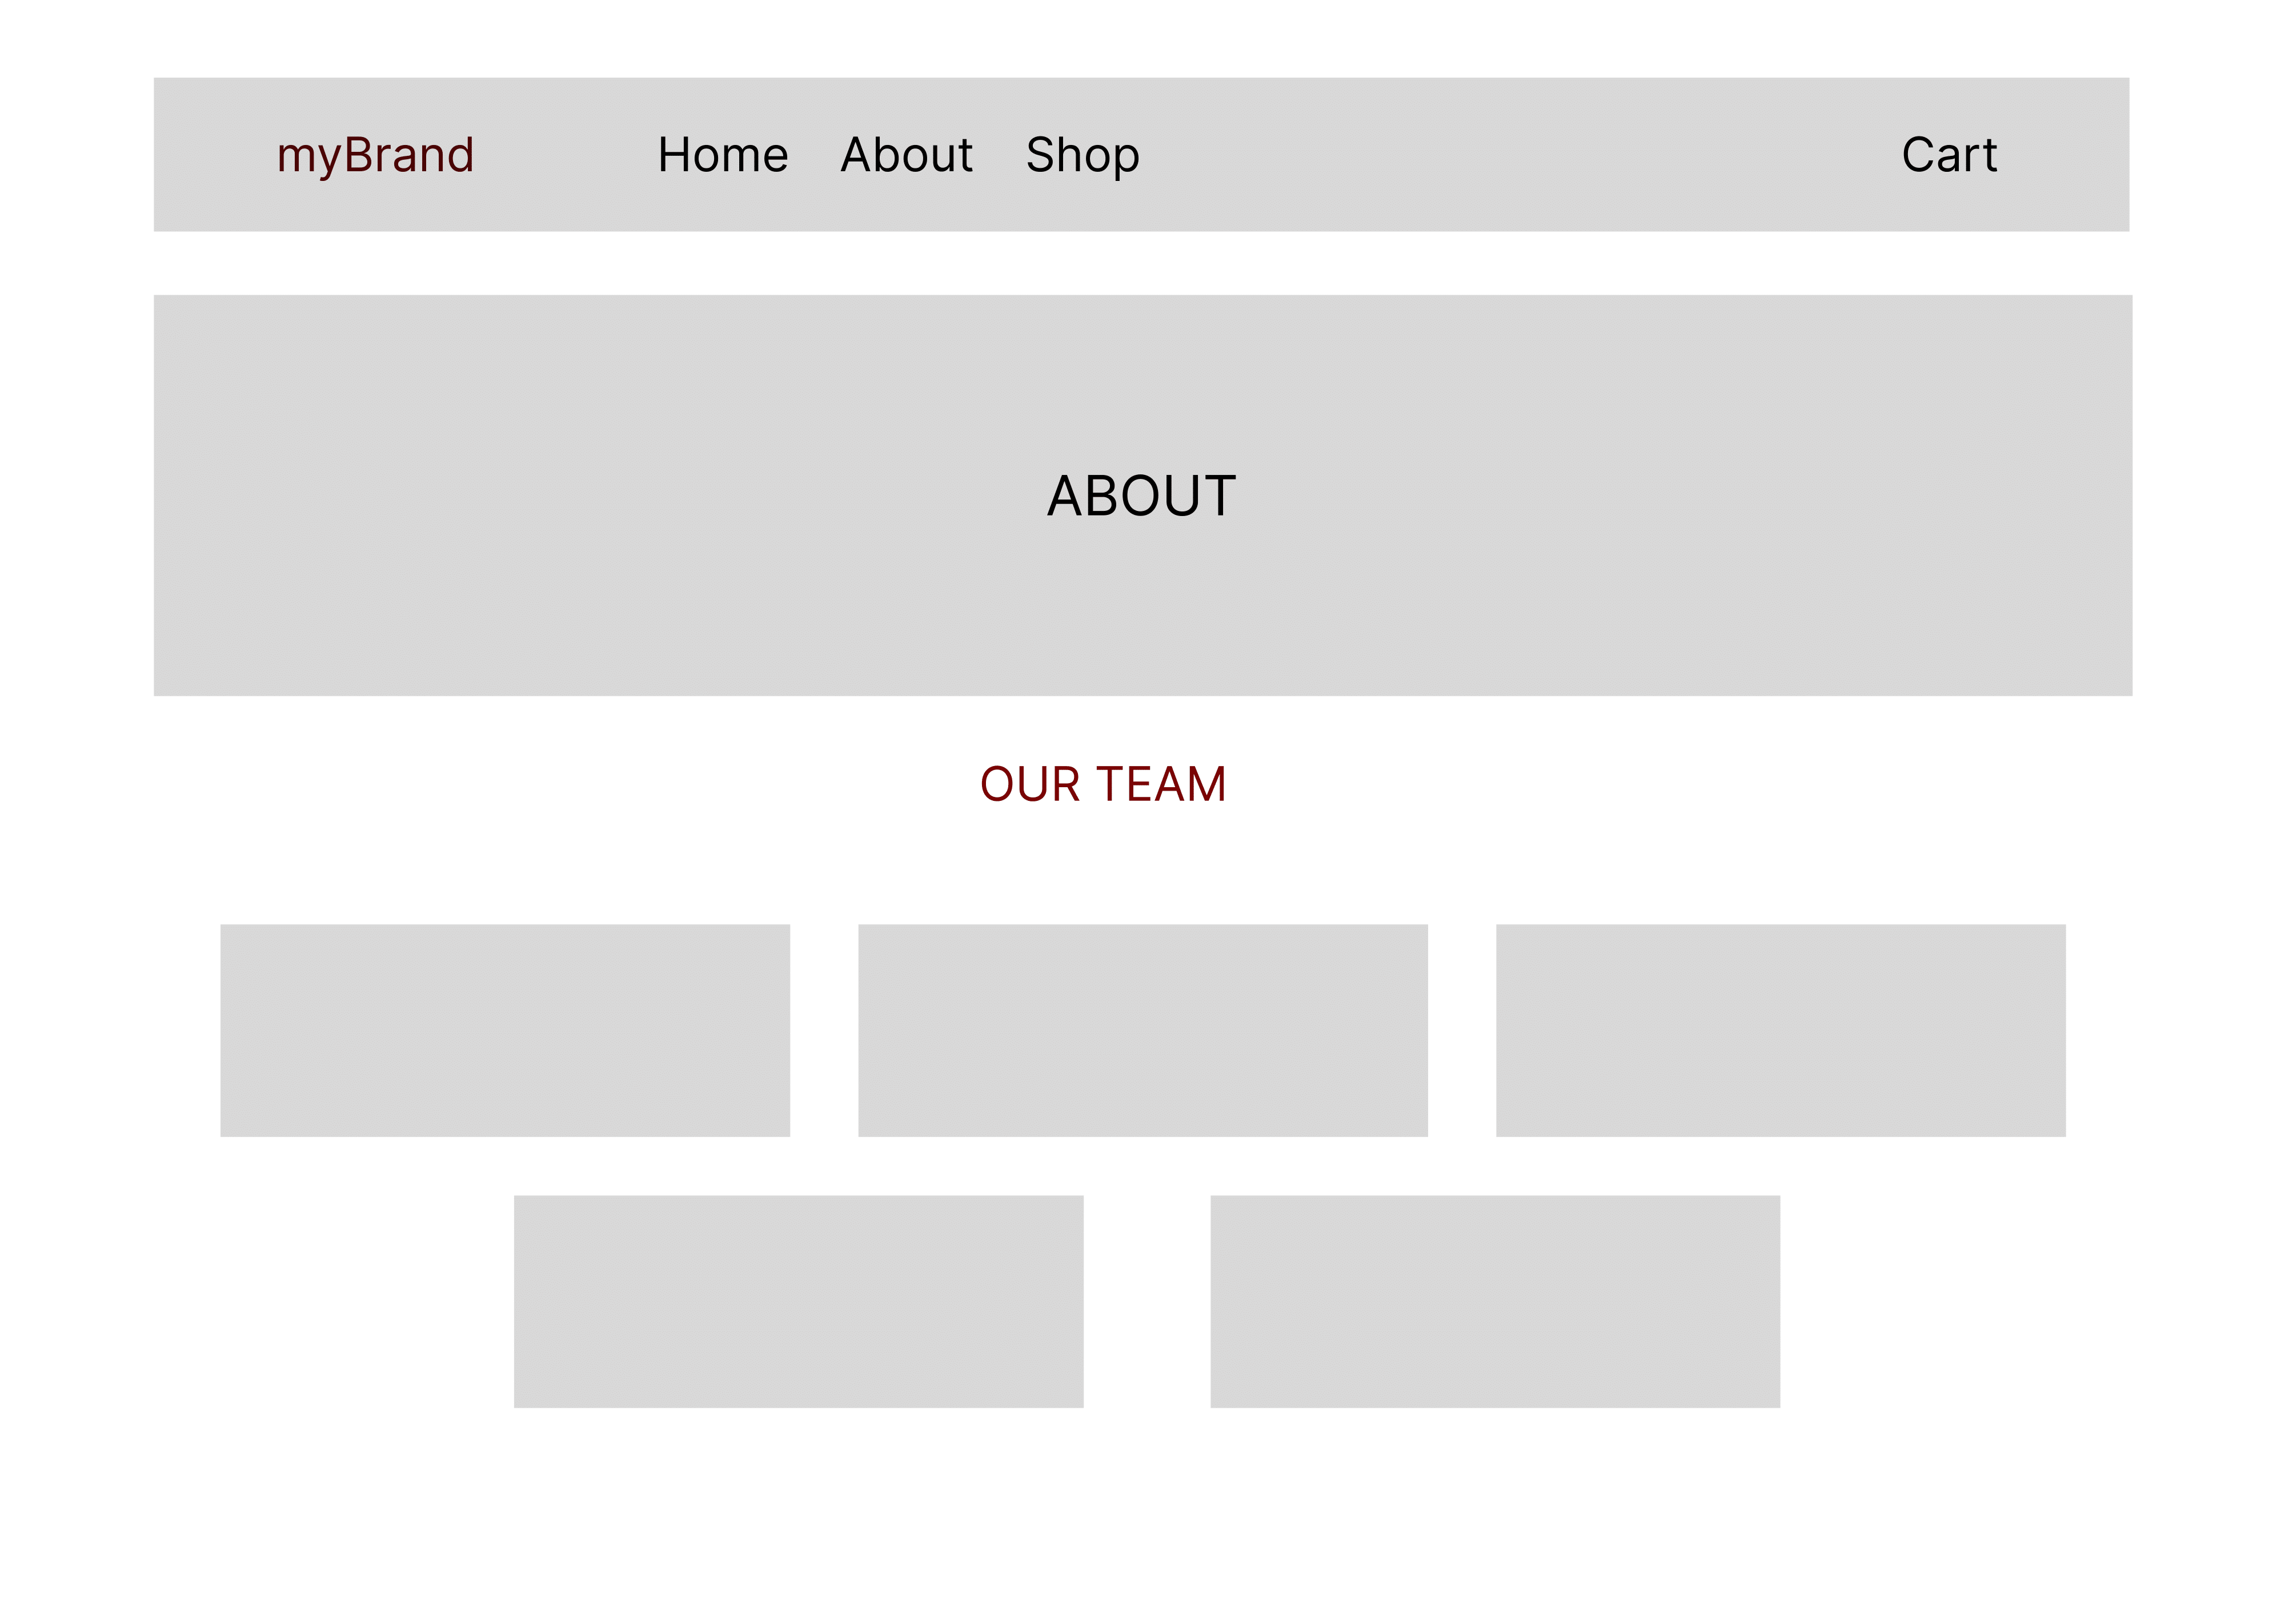

Slide 6
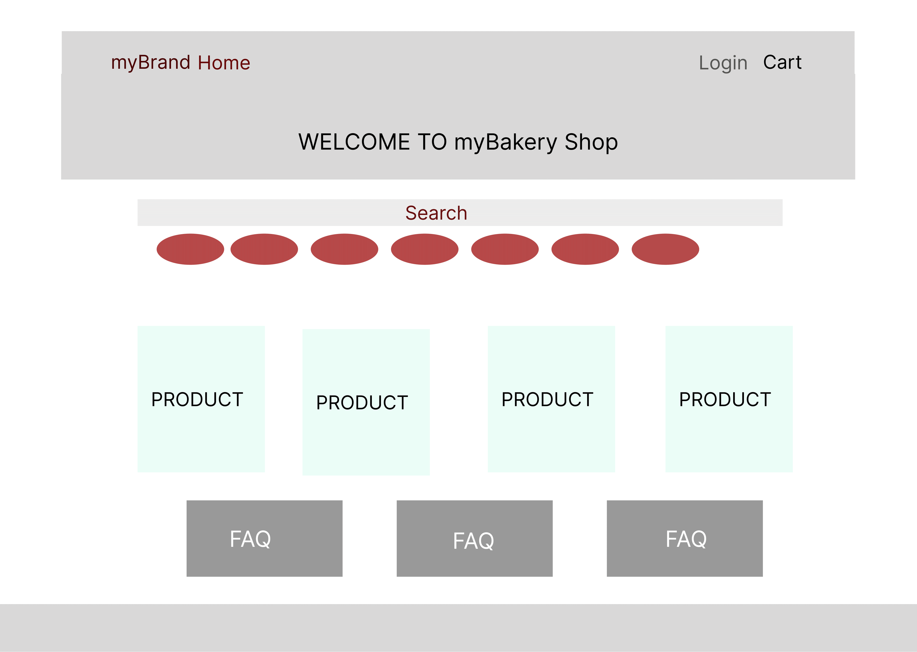

Slide 7
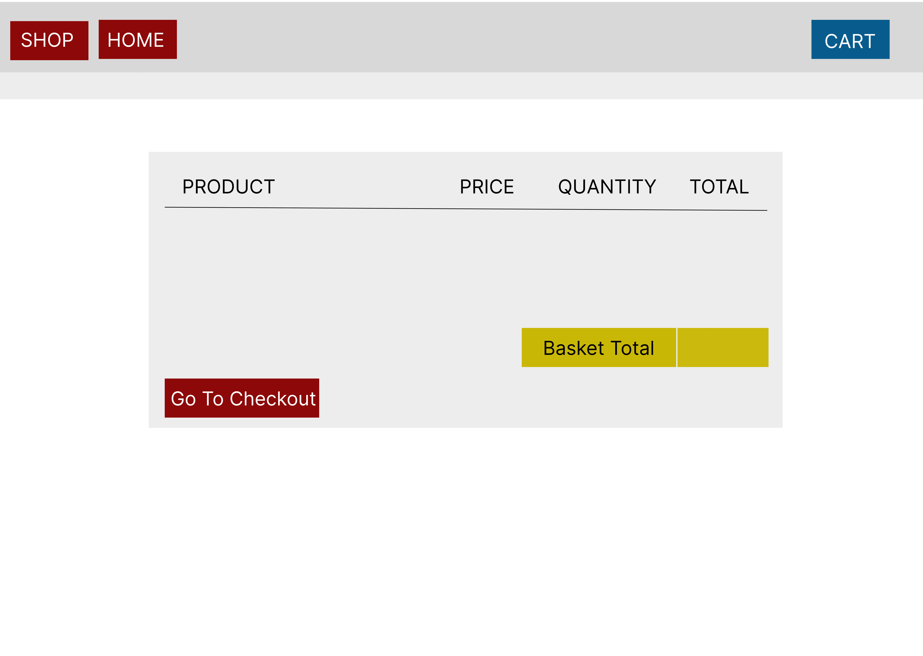

Slide 8
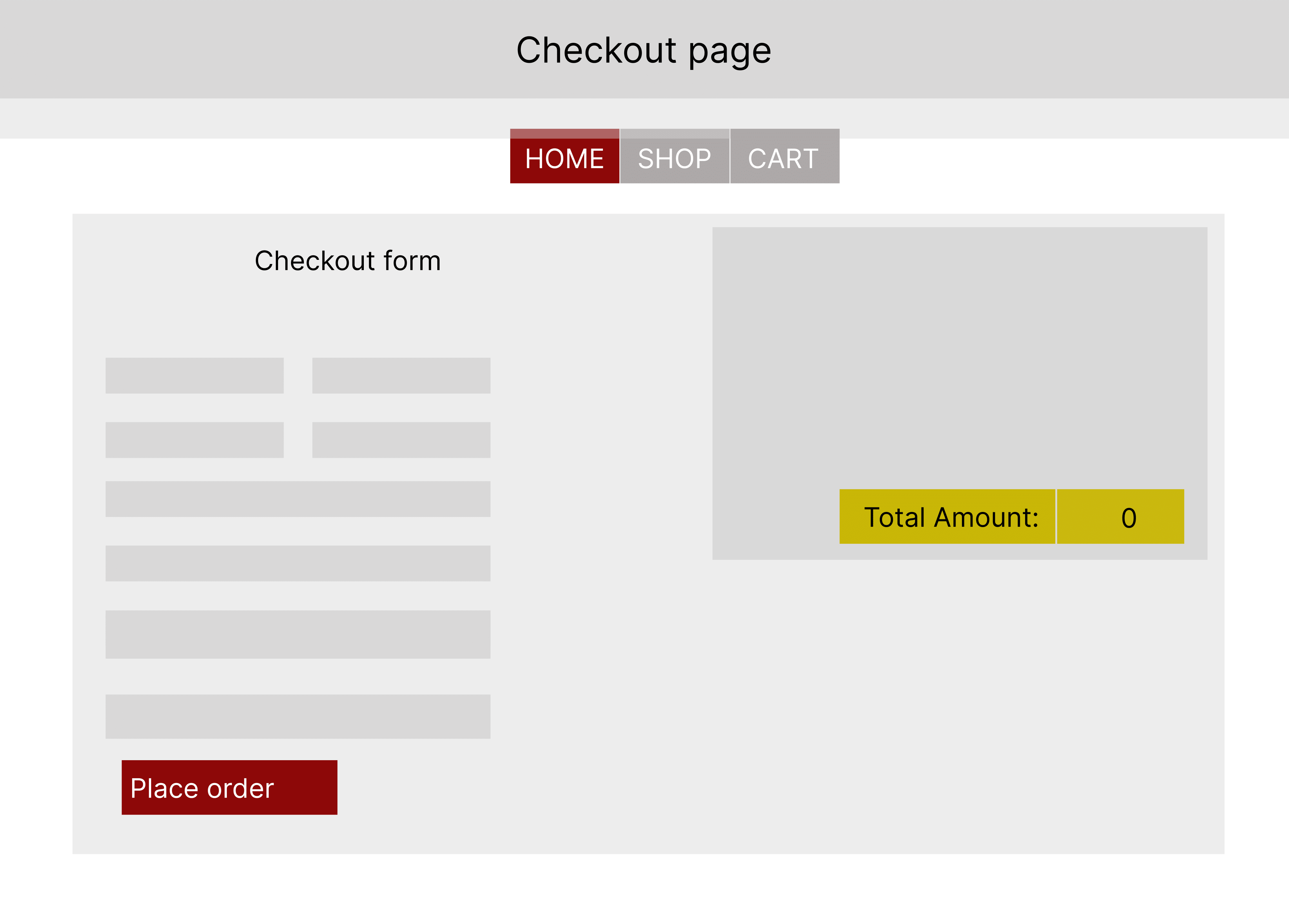

Slide 9
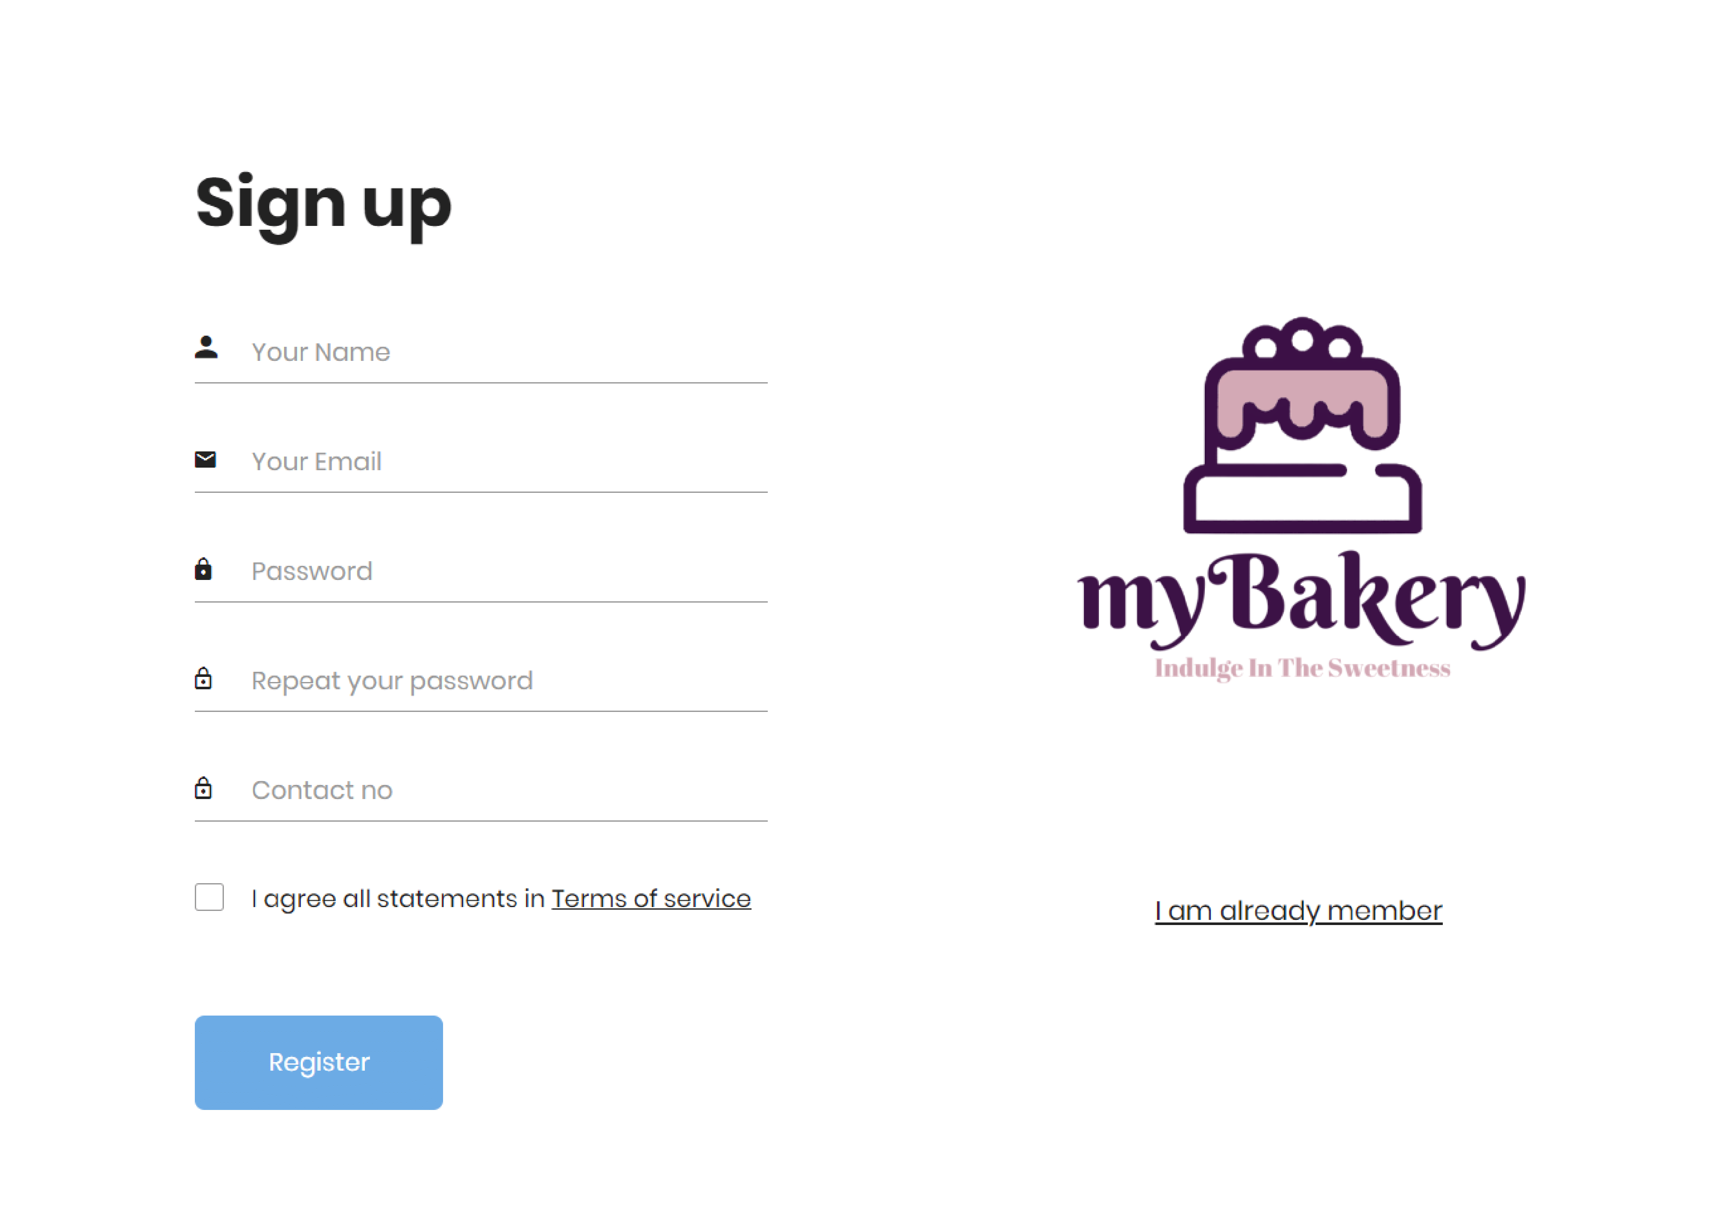

Slide 10
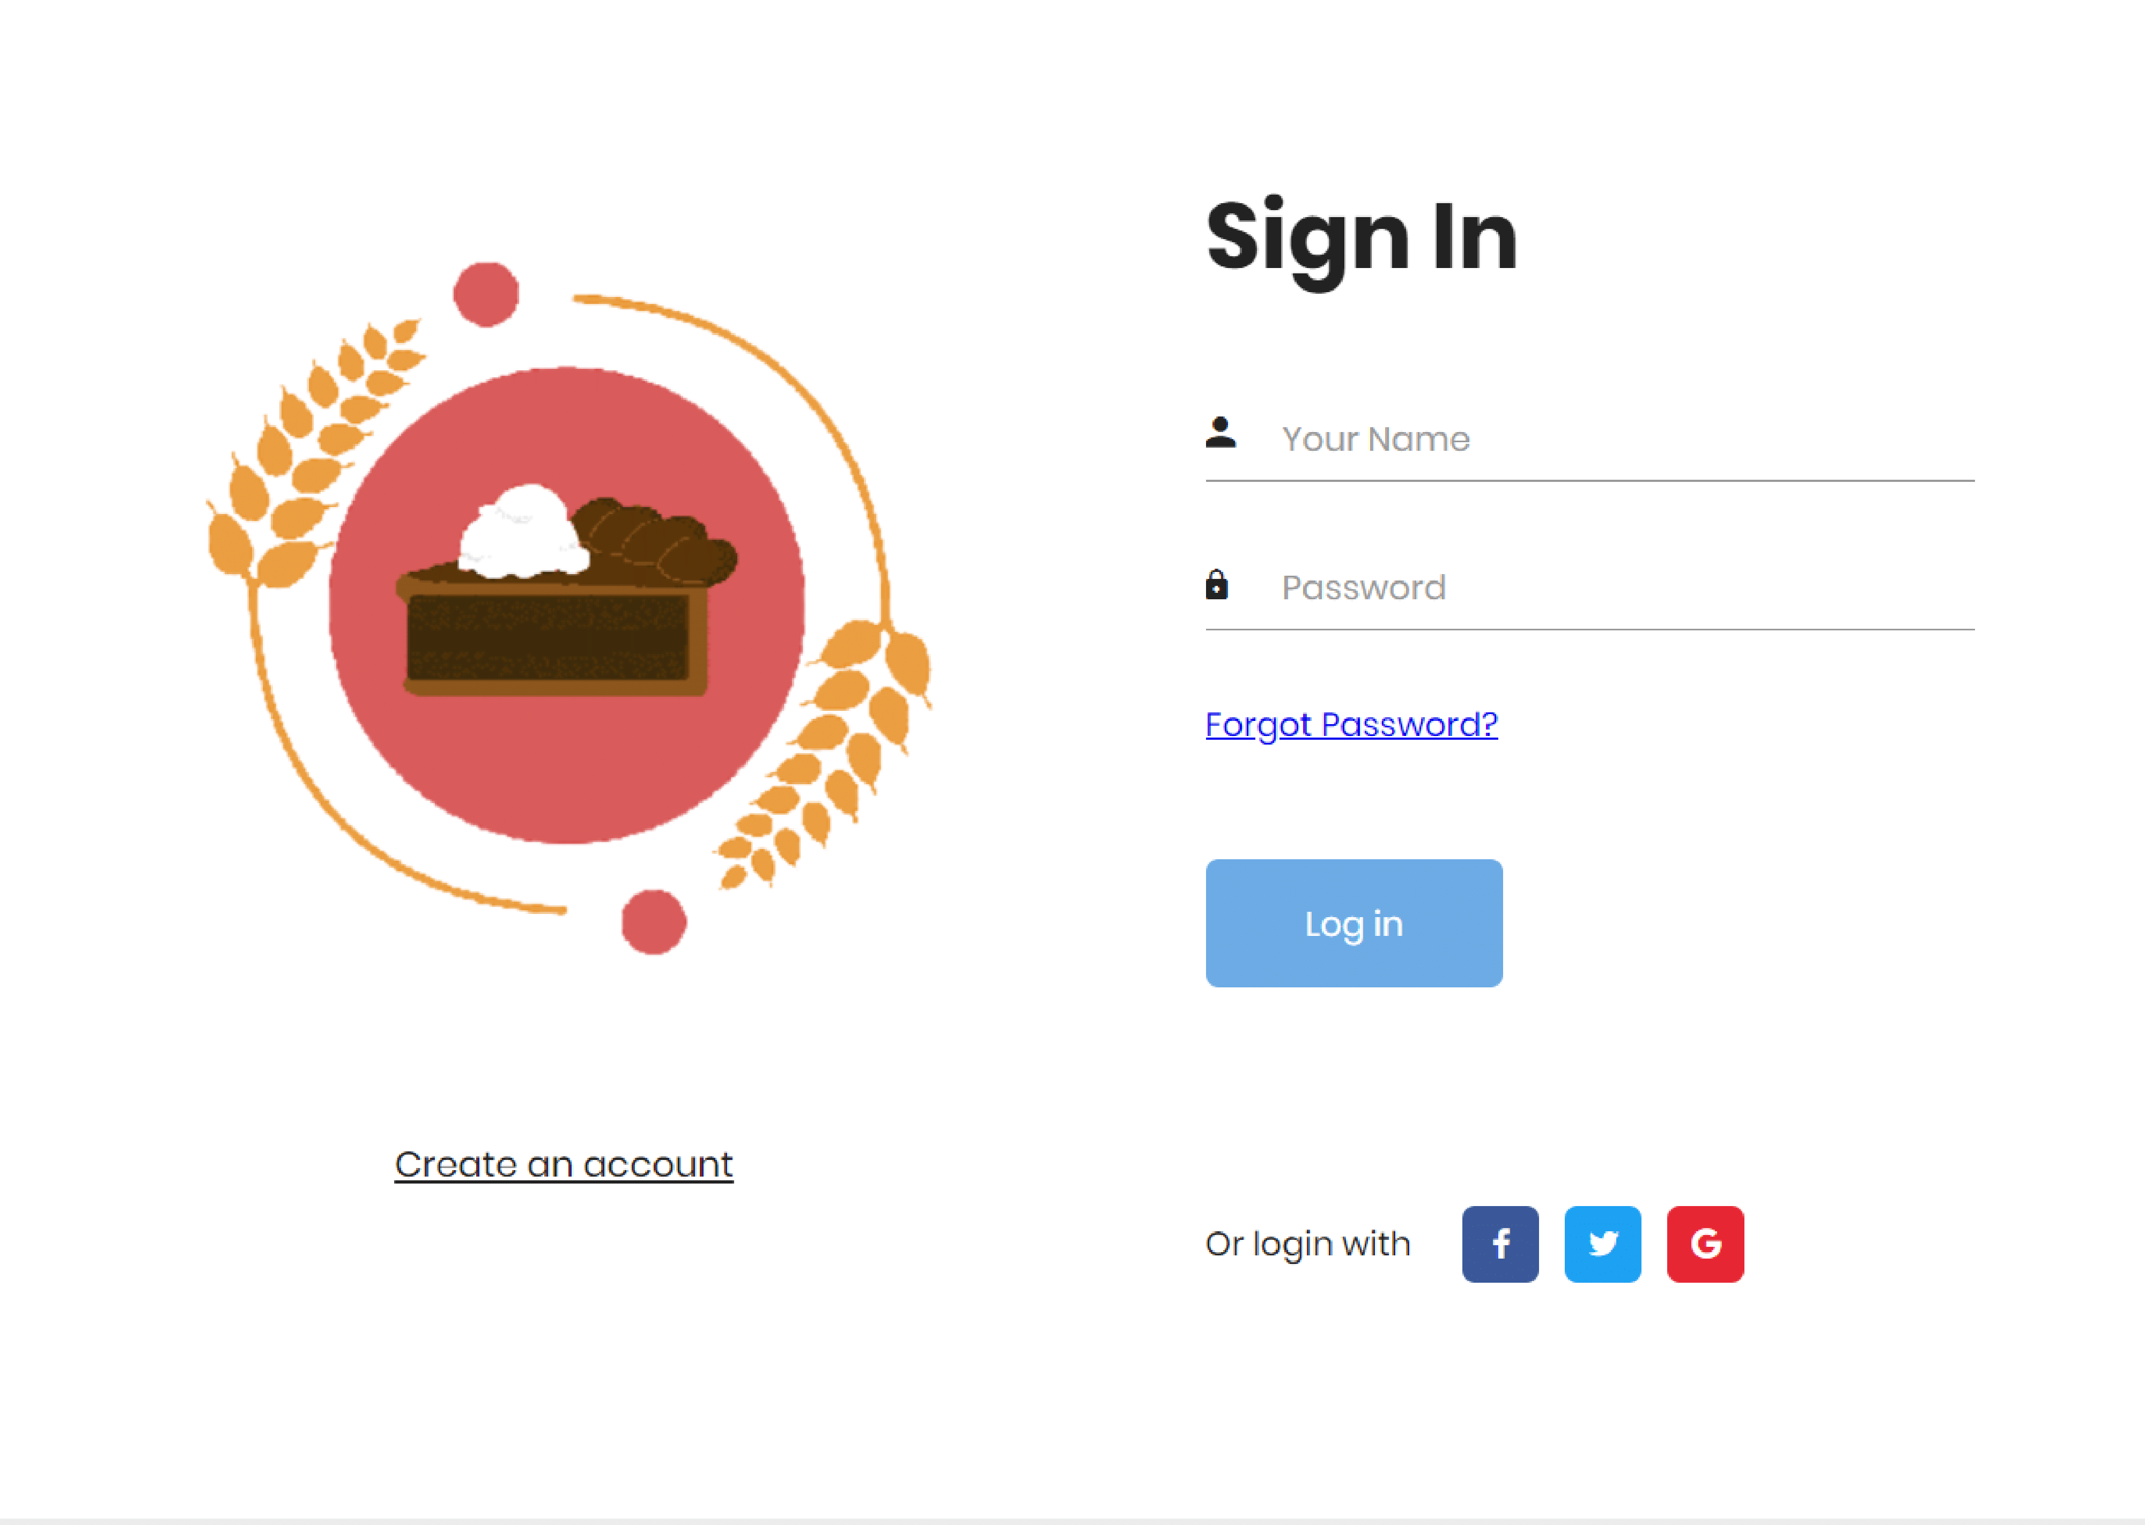

Slide 11
Thank You!
______________________________________________________________________________
1.Md. Mehmood Alam 2.Priyanjali Das 3.Srinjoy Gupta 4.Debanjan Dhar
5.Shafaque Bushra

